Slide 1
How to build a brain from scratch
Lecture 1:
Reinforcement learning

Slide 2

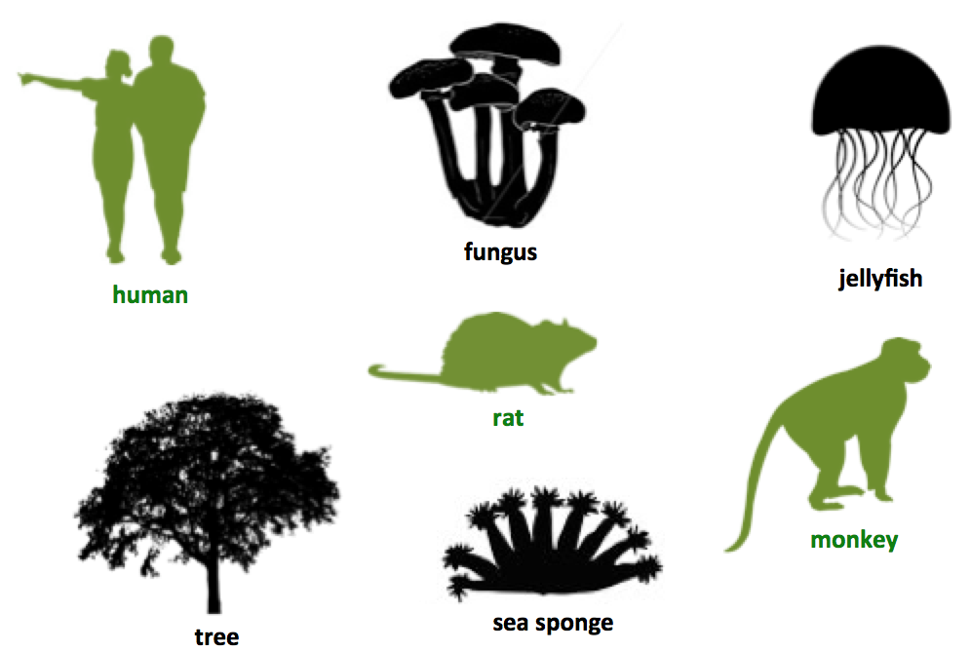
Defining the brain?
Being an animal, or being a large or complex organism, are not sufficient conditions for having a brain
Brains are information processing systems that evolved to coordinate actions in response to complex sensory inputs

Slide 3
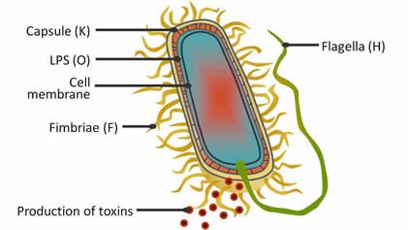
Single-celled organisms
Escherichia Coli
Even the bacterium E Coli can sense favoured and disfavoured chemicals in the local environment
It navigates towards favoured chemicals, using “running” and “tumbling” movements
However, the behavior of this system is not modifiable with experience, but hardcoded by evolution

Slide 4
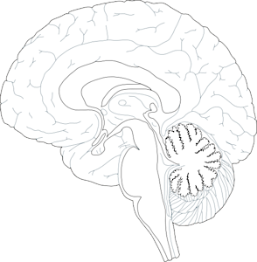
Basal ganglia and dACC
the striatum and dACC form a circuit for learning the value of actions
The dACC is the major efferent target of the striatum, and is phylogenetically more ancient than overlying 6-layer cortex
dorsal ACC
striatum
midbrain
Notes:
Let’s begin with a question. What is really special about human intelligence? What makes us distinctive from that of other highly intelligent species, such as monkeys and birds?
Well, there are lots of anwers to this question, but in this talk I’d like to focus on one of them.

Slide 5
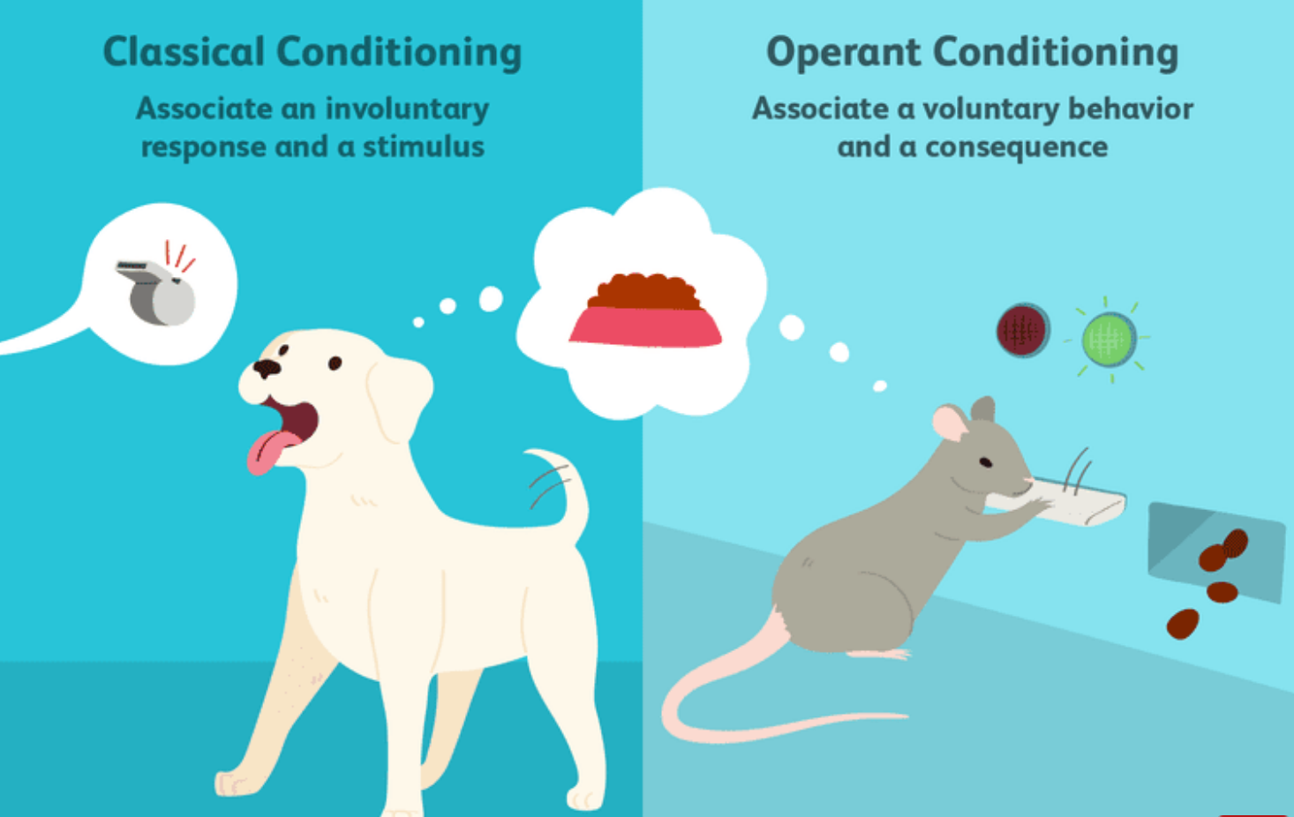
Classical and operant conditioning
US
CS
CR
Developing associations between events (Pavlov)
Learning the consequences of actions (Thorndike, Skinner)
Notes:
Let’s begin with a question. What is really special about human intelligence? What makes us distinctive from that of other highly intelligent species, such as monkeys and birds?
Well, there are lots of anwers to this question, but in this talk I’d like to focus on one of them.

Slide 6
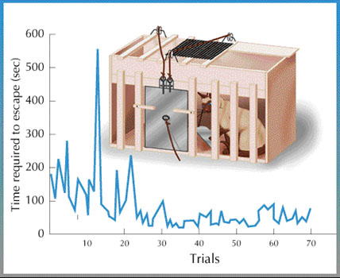
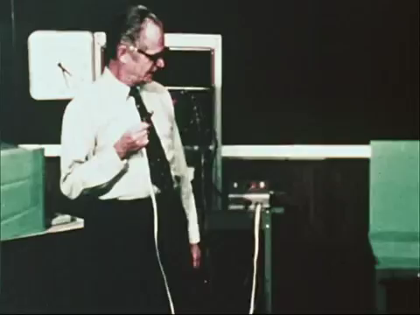
Thorndike, Skinner and the law of effect
Actions that are rewarded will be repeated more often
Notes:
Let’s begin with a question. What is really special about human intelligence? What makes us distinctive from that of other highly intelligent species, such as monkeys and birds?
Well, there are lots of anwers to this question, but in this talk I’d like to focus on one of them.

Slide 7
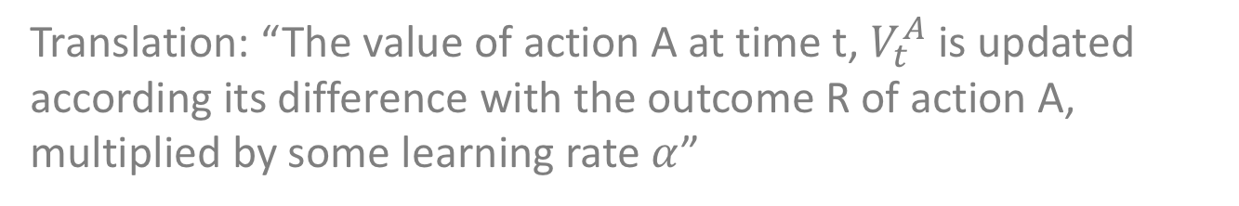
Delta rule model
Without further elaboration, the Rescorla-Wagner rule can account for operant learning:
$V_{t}^{A}=$ $V_{t−1}^{A}+ α∙(R−V_{t−1}^{A})$
Translation: “The value of action A at time t, $V_{t}^{A}$ is updated according its difference with the outcome R of action A, multiplied by some learning rate $α$”
This is sometimes also called a “delta rule model”
Notes:
Let’s begin with a question. What is really special about human intelligence? What makes us distinctive from that of other highly intelligent species, such as monkeys and birds?
Well, there are lots of anwers to this question, but in this talk I’d like to focus on one of them.

Slide 8
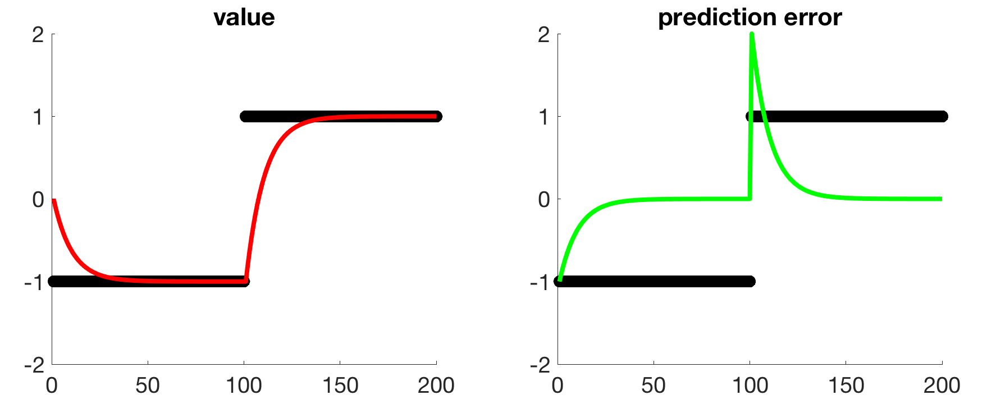
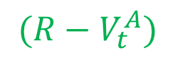
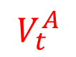
Example delta-rule model
$$V_{t}^{A}$$
$$(R−V_{t}^{A})$$
In this simulation, the model is applied to track a quantity that changes value after 100 cycles
$V_{t}^{A}=$ $V_{t−1}^{A}+ α∙(R−V_{t}^{A})$
code #1: delta rule model
Notes:
Let’s begin with a question. What is really special about human intelligence? What makes us distinctive from that of other highly intelligent species, such as monkeys and birds?
Well, there are lots of anwers to this question, but in this talk I’d like to focus on one of them.

Slide 9
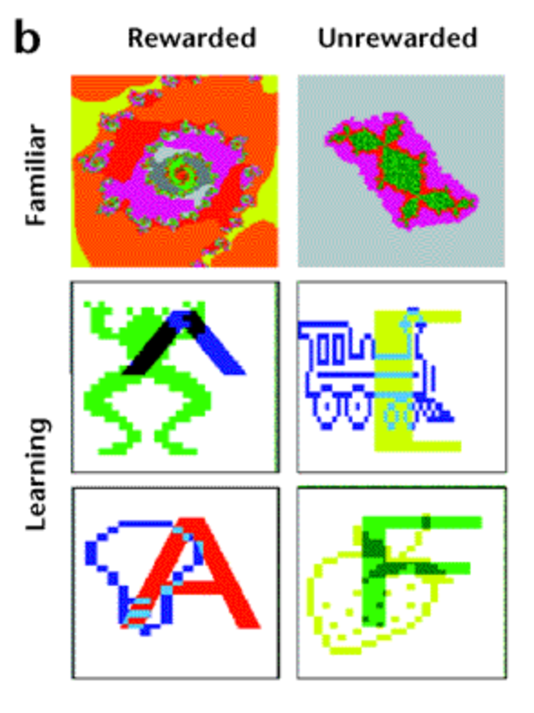
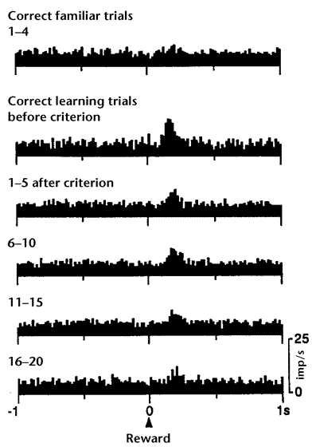
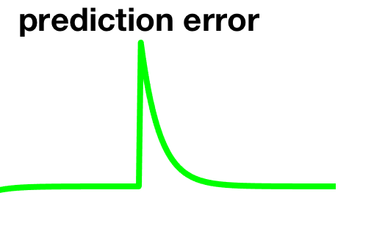
Example delta-rule model
In an operant (visual discrimination) task, the responses of VTA dopamine cells to reward declined gradually during new learning
Hollerman & Schultz 1998
Notes:
Let’s begin with a question. What is really special about human intelligence? What makes us distinctive from that of other highly intelligent species, such as monkeys and birds?
Well, there are lots of anwers to this question, but in this talk I’d like to focus on one of them.

Slide 10
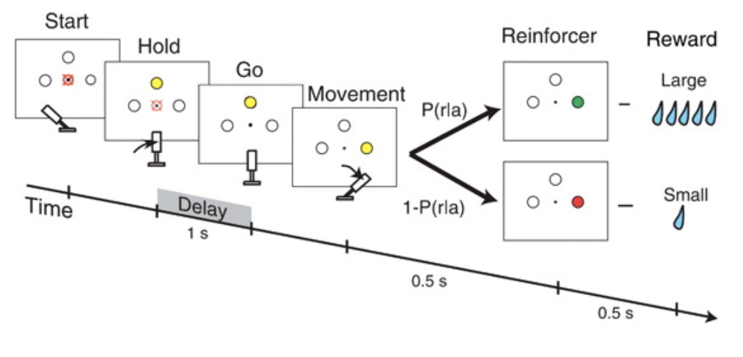
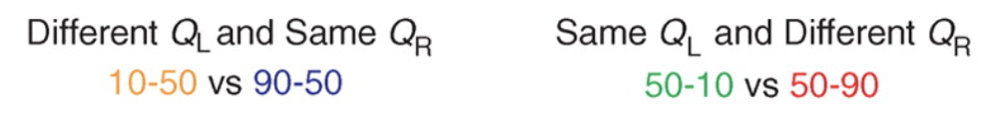
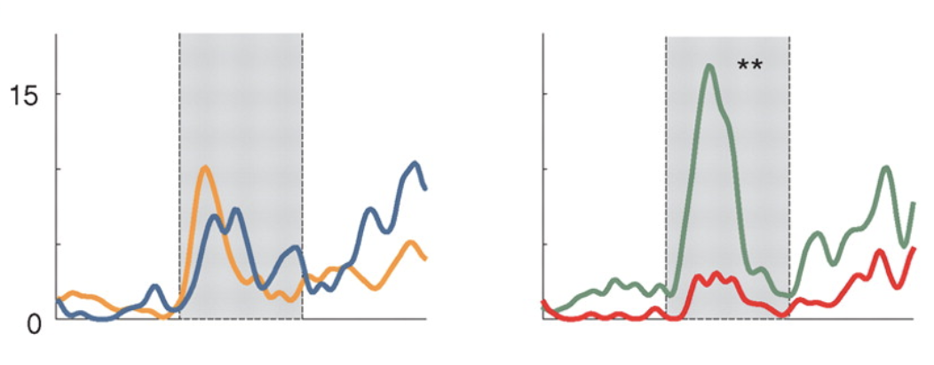
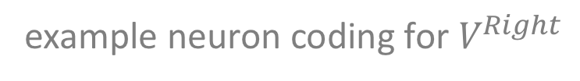
Action value coding neurons in striatum
Monkeys made voluntary saccades to spatial locations to obtain rewards with varying probability
Cells in the striatum code for action values
example neuron coding for $V^{Right}$
Samejima et al 2005
Notes:
Let’s begin with a question. What is really special about human intelligence? What makes us distinctive from that of other highly intelligent species, such as monkeys and birds?
Well, there are lots of anwers to this question, but in this talk I’d like to focus on one of them.

Slide 11
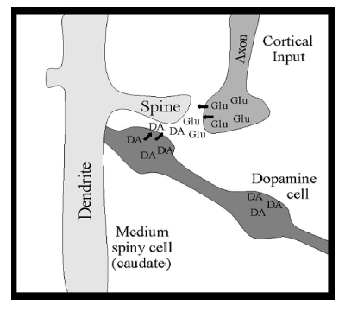
Action value coding neurons in striatum
from sensory
system
to motor system
Sensorimotor learning proceeds by Hebbian plasticity in the striatum
Dopamine acts as a gate, so that associations are only enhanced in the presence of reward
from reward system
Reynolds, 2001
Notes:
Let’s begin with a question. What is really special about human intelligence? What makes us distinctive from that of other highly intelligent species, such as monkeys and birds?
Well, there are lots of anwers to this question, but in this talk I’d like to focus on one of them.

Slide 12
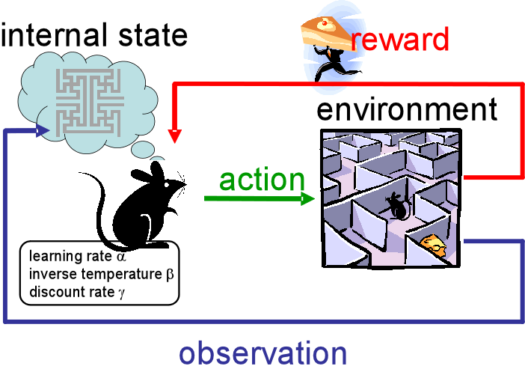
Reinforcement learning
Rewards are assumed to be “emitted” by the environment
The framework of reinforcement learning describes how a system learns to select actions on the basis of observations and rewards
Sutton & Barto, 1998

Slide 13
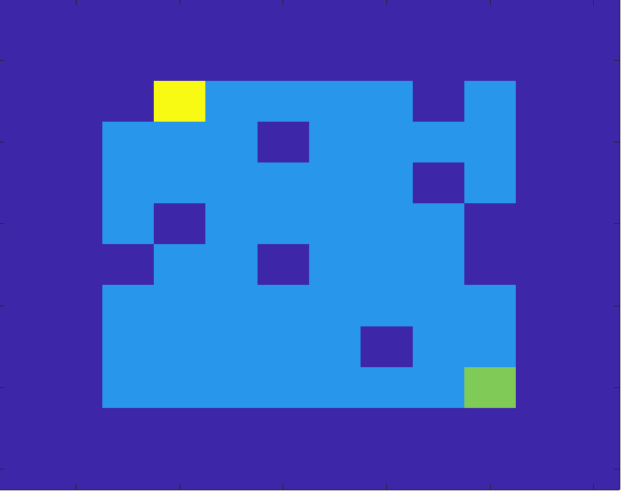




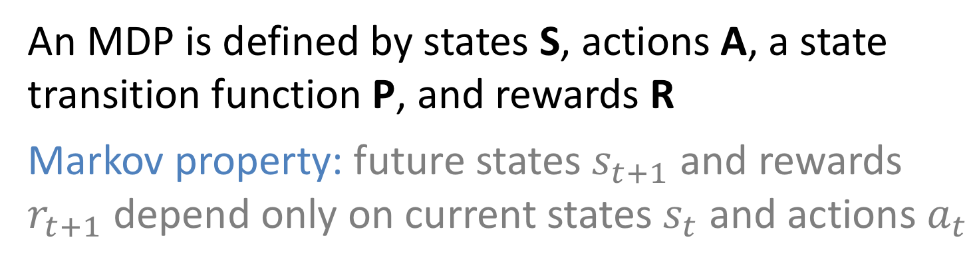
Markov decision process (MDP)
Agent
How can the agent (green) learn to reach the yellow?
Fruit
Empty
Wall
An MDP is defined by states S, actions A, a state transition function P, and rewards R
Markov property: future states $s_{t+1}$ and rewards $r_{t+1}$ depend only on current states $s_{t}$ and actions $a_{t}$
Sutton & Barto, 1998

Slide 14
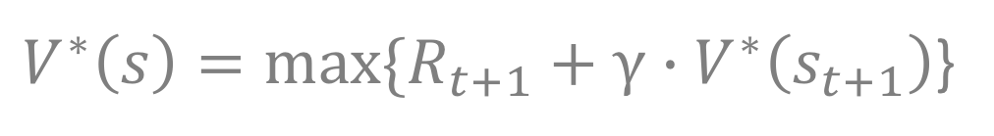
Bellman equation
What is the best policy in an MDP?
A policy is a definition of the action you should take in each state to maximise reward
Optimal solution is given by the Bellman Equation:
discount function
$V^{∗}\left(s\right)=max⁡\{R_{t+1}+$ $γ∙V^{∗}\left(s_{t+1}\right)$}
The discount function that determines how much you prefer rewards now vs. later
reward just coming
value of next state
compute recursively (expensive)
Sutton & Barto, 1998

Slide 15
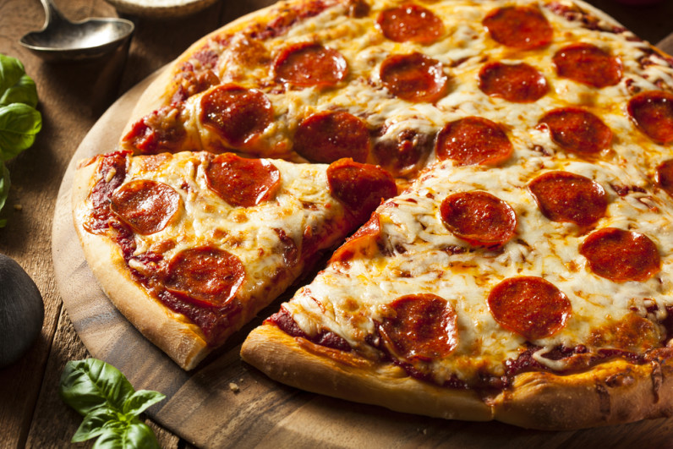



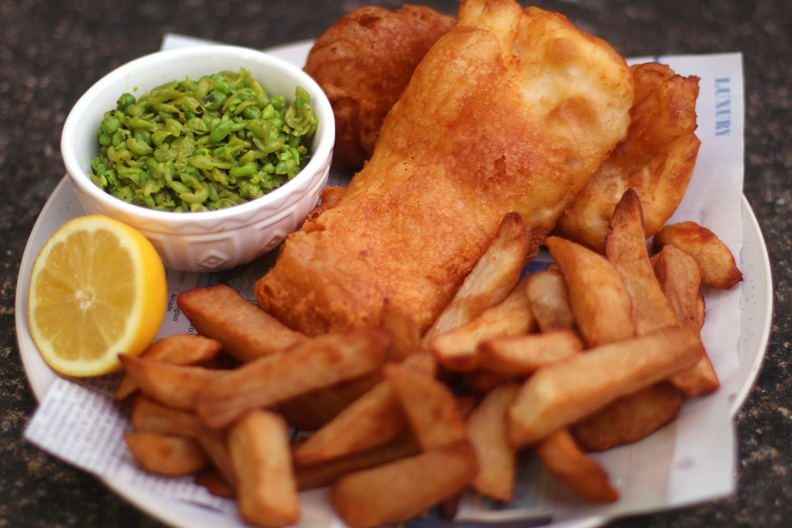
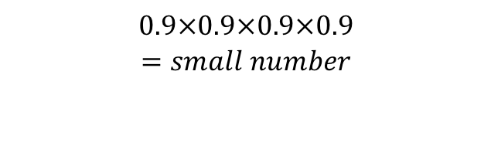
Bellman equation
Monday
Tuesday
Wednesday
Thursday
Friday
pizza = 0.7
salad = 0.3
chicken = 0.6
sushi = 0.5
fish = 0.9
It is Monday. What is the value of the menu this week?
discounted future reward
$V^{∗}\left(mon\right)=R\left(pizza\right)+γ∙R(salad)+γ^{2}∙R(chicken)$ $+γ^{3}∙R(sushi)$ $+γ^{4}∙R(fish)$
today’s reward
$$0.9×0.9×0.9×0.9$$
$$=small number$$
Sutton & Barto, 1998

Slide 16

Bellman equation
Monday
Tuesday
Wednesday
Thursday
Friday
R = 0
R = 0
R = 0
R = 0
R = 1
What about this week? Monday is boring, but on the other hand, your birthday is coming up.
discounted future reward
$V^{∗}\left(mon\right)=R\left(mon\right) + γ∙R(tues)+γ^{2}∙R(wed)$ $+γ^{3}∙R(thurs)$ $+γ^{4}∙R(friday)$
today’s reward
not zero! (but not 1, because discounted multiple times)

Slide 17
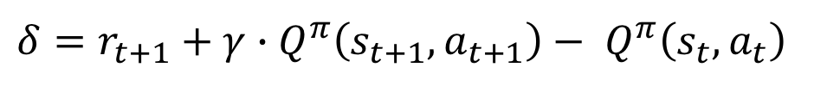
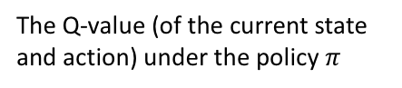
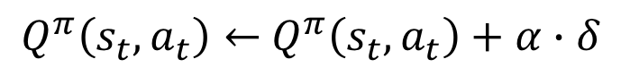
TD learning (on-policy) a.k.a. SARSA
We can approximate the optimal solution using temporal difference (TD) learning:
learning rate
$Q^{π}\left(s_{t},a_{t}\right)←$ $Q^{π}\left(s_{t},a_{t}\right)+α∙δ$
The Q-value (of the current state and action) under the policy $π$
prediction error
$$δ=r_{t+1}+γ∙Q^{π}\left(s_{t+1},a_{t+1}\right)− Q^{π}\left(s_{t},a_{t}\right)$$
reward for next state
Q-value for the next state/action
Q-value for current state/action
Note that the only addition to the delta rule is the new term for discounted reward of future action
Sutton & Barto, 1998

Slide 18
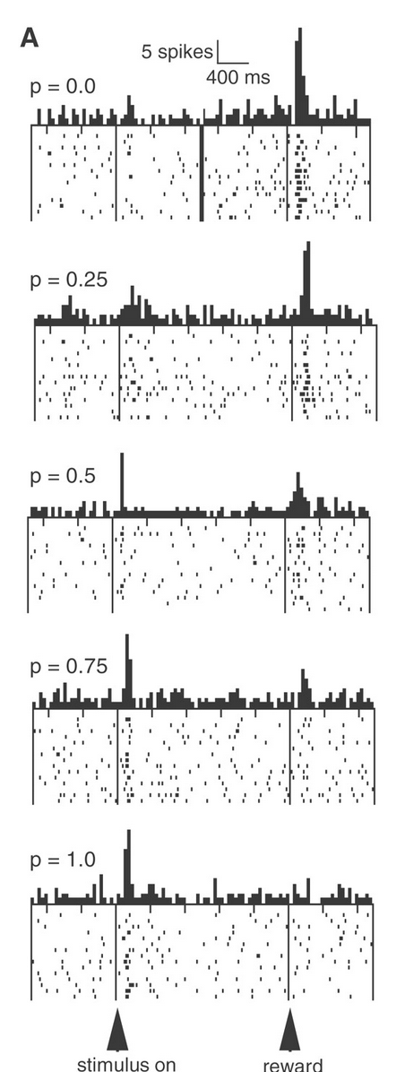
Dopamine & Pavolvian conditioning
Dopamine neurons in VTA following onset of a reward-predictive stimulus and the receipt of reward
When the reward is unexpected, the neurons signal a reward prediction error (RPE)
When the reward is expected, the signal shifts to the predictive cue
Fiorillo et al 2003
Notes:
Let’s begin with a question. What is really special about human intelligence? What makes us distinctive from that of other highly intelligent species, such as monkeys and birds?
Well, there are lots of anwers to this question, but in this talk I’d like to focus on one of them.

Slide 19
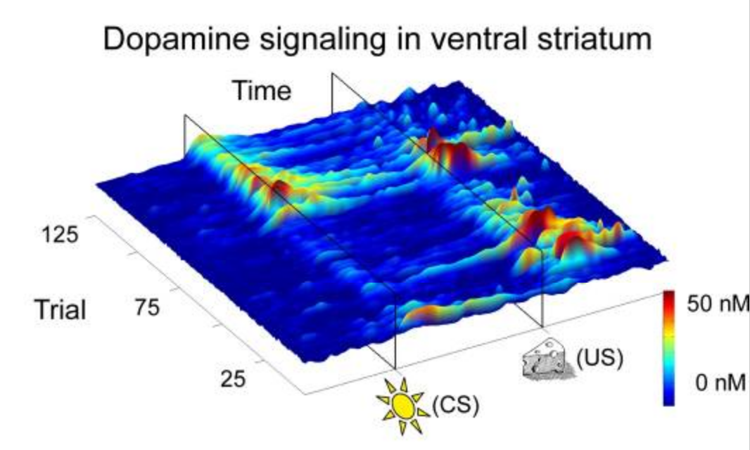
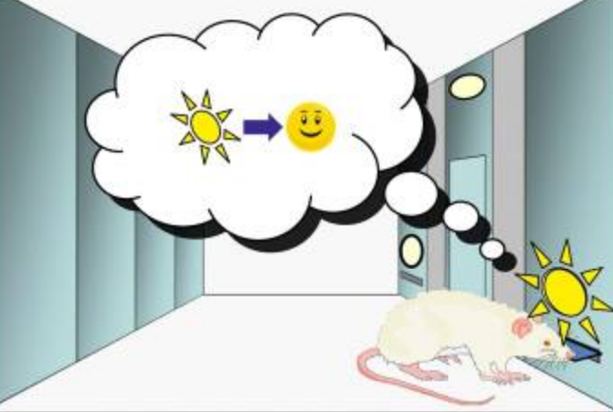
Dopamine & Pavolvian conditioning
Dopamine concentration in ventral striatum measured with fast-scan cyclic voltammetry
Dopamine signaling in ventral striatum (nucleus accumbens) responds first to US, then (after training) to CS.
Flagel et al 2011
Notes:
Let’s begin with a question. What is really special about human intelligence? What makes us distinctive from that of other highly intelligent species, such as monkeys and birds?
Well, there are lots of anwers to this question, but in this talk I’d like to focus on one of them.

Slide 20

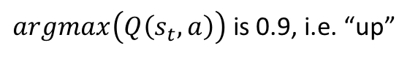
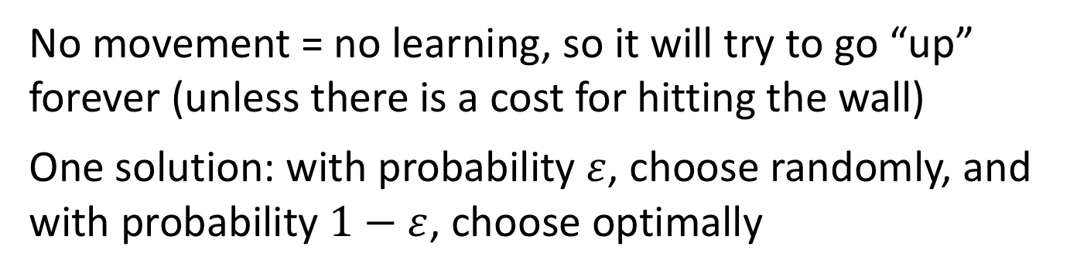
Epsilon-greedy action selection
If the agent always chooses the most valuable action(“greedy” choice) then it risks getting “stuck”
Imagine our agent had learned the following Q-values:
up down left right
0.9 0.8 0.2 0.1
$argmax\left(Q\left(s_{t},a\right)\right)$ is 0.9, i.e. “up”
No movement = no learning, so it will try to go “up” forever (unless there is a cost for hitting the wall)
One solution: with probability $ε$, choose randomly, and with probability $1−ε$, choose optimally

Slide 21
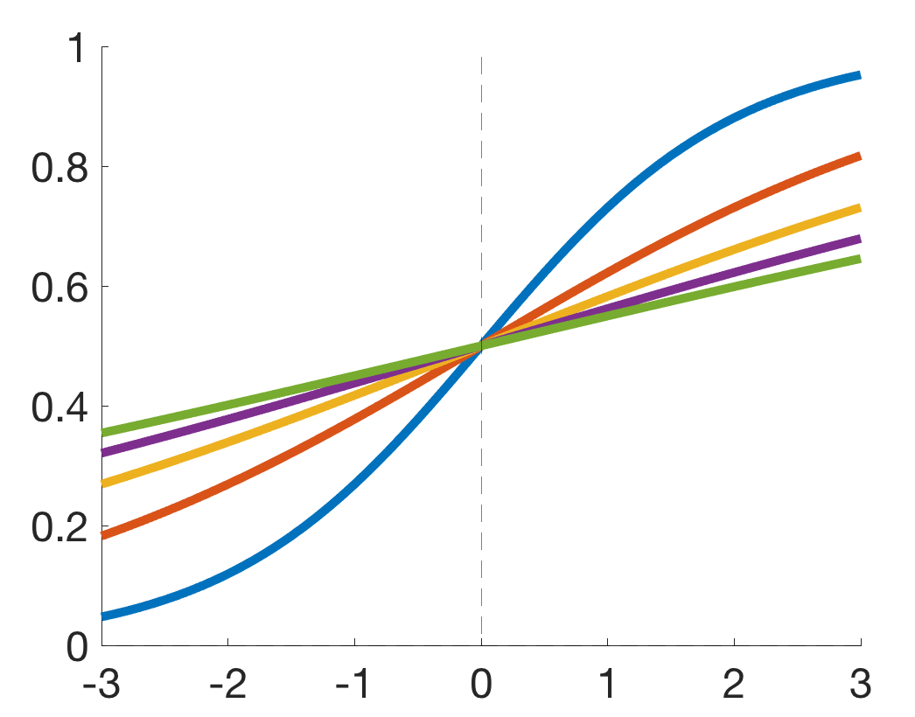


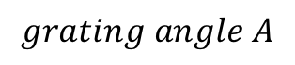
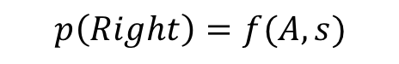
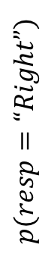
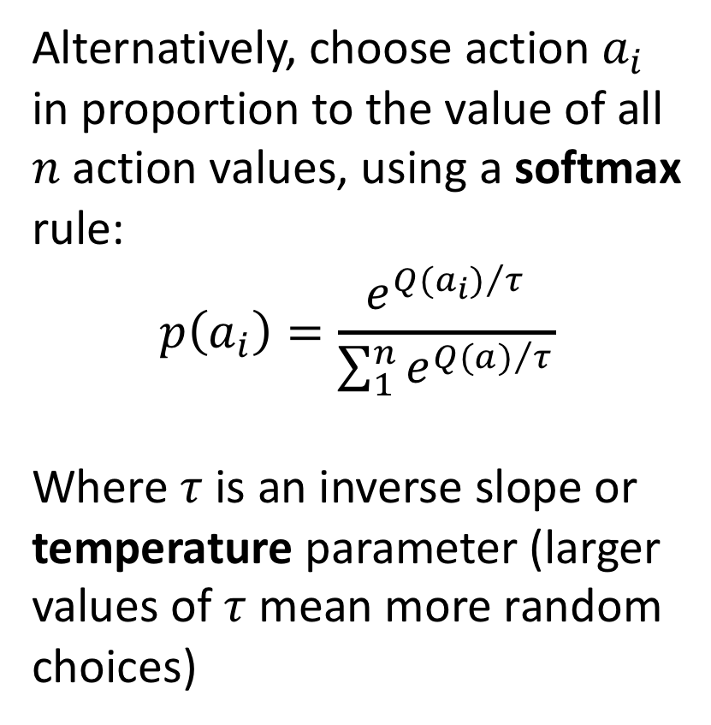
Softmax action selection
$$p\left(Right\right)=f(A,s)$$
Alternatively, choose action $a_{i}$ in proportion to the value of all $n$ action values, using a softmax rule:
$$p\left(a_{i}\right)=\frac{e^{{Q(a_{i})}/τ}}{\sum_{1}^{n}{e^{{Q(a)}/τ}}}$$
Where $τ$ is an inverse slope or temperature parameter (larger values of $τ$ mean more random choices)
$$p(resp=“Right”)$$
s = 1
s = 2
s = 3
s = 4
s = 5
$$grating angle A$$
Decisions made by animals are subject to intrinsic variability

Slide 22
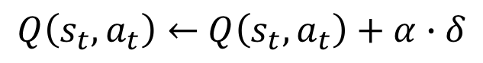
Q learning (off-policy)
A similar method updates according to the value of the best possible (future) action, not that dictated by the current policy:
learning rate
$Q\left(s_{t},a_{t}\right)←$ $Q\left(s_{t},a_{t}\right)+α∙δ$
The Q-value (of the current state and action)
prediction error
$$δ=r_{t+1}+γ∙Q^{max}\left(s_{t+1},a_{t+1}\right)− Q\left(s_{t},a_{t}\right)$$
reward for next state
Best Q-value for the next state
Q-value for current state/action
Note that the only addition to the delta rule is the new term for discounted reward of future action
Watkins, 1990

Slide 23
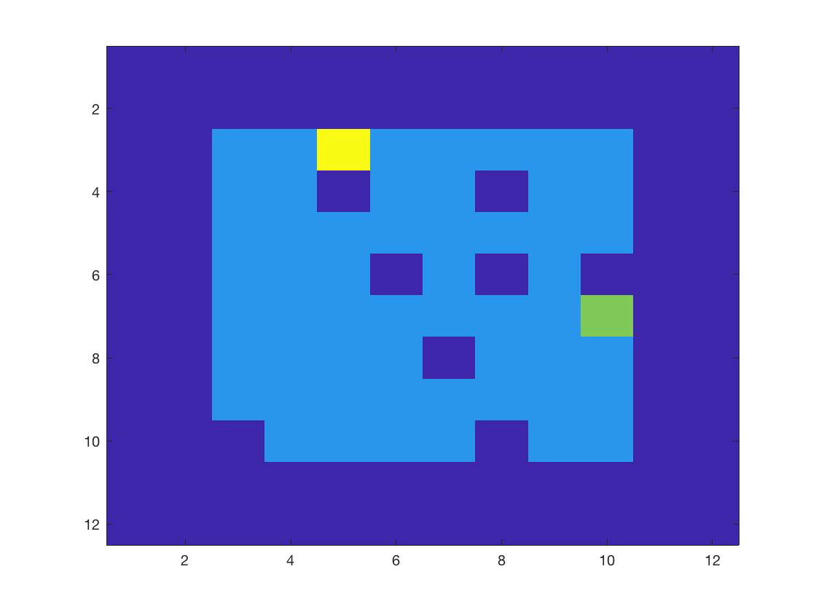
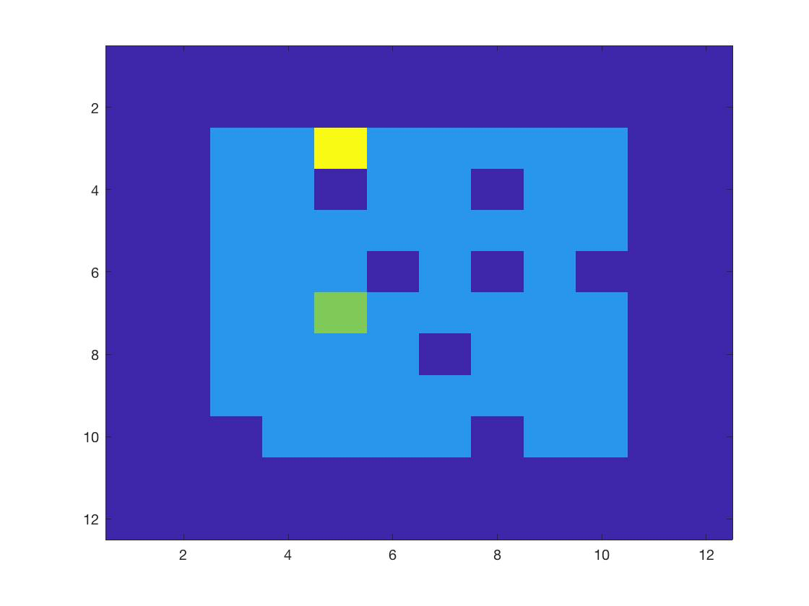
Reinforcement learning
early in training
midway
late in training
At first, the agent behaves randomly
By the end of training, it behaves optimally (makes a beeline for the goal, irrespective of the start location).
Sutton & Barto, 1998

Slide 24
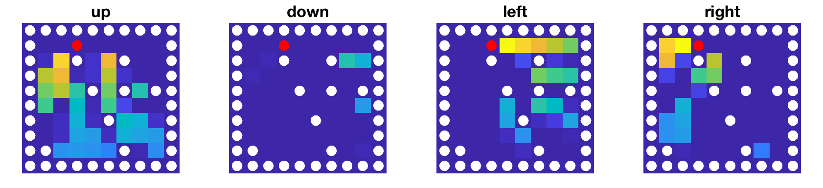
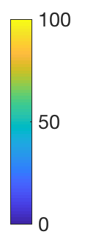
Q-values
red dot is the goal location; white dots are the walls
Visualisation of the Q-values reveals the policy the agent has learned. The rewards are “backed up” from the goal to adjacent states.
Sutton & Barto, 1998

Slide 25
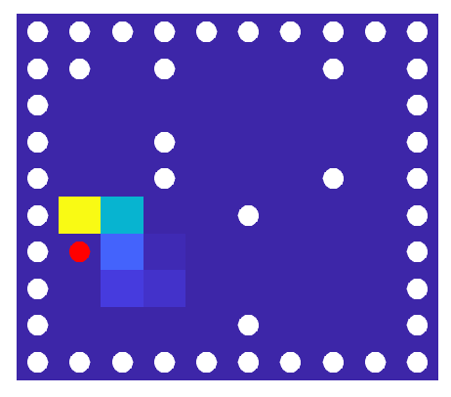
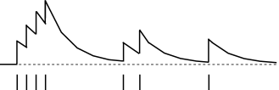
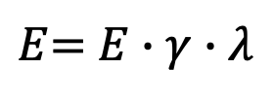
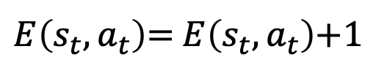
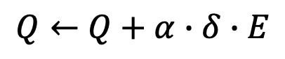
Eligibility trace
An eligibility trace allows the reward to be backed up faster through recently visited (or “eligible”) states, rather than just the current state
$Q←$ $Q+α∙δ∙E$
eligibility trace
$E$= $E∙γ∙λ$
decay eligibility trace by lambda + discount (gamma)
$E\left(s_{t},a_{t}\right)$= $E\left(s_{t},a_{t}\right)$+1
update current state by 1
eligibility trace for one state
visits
Sutton & Barto, 1998

Slide 26
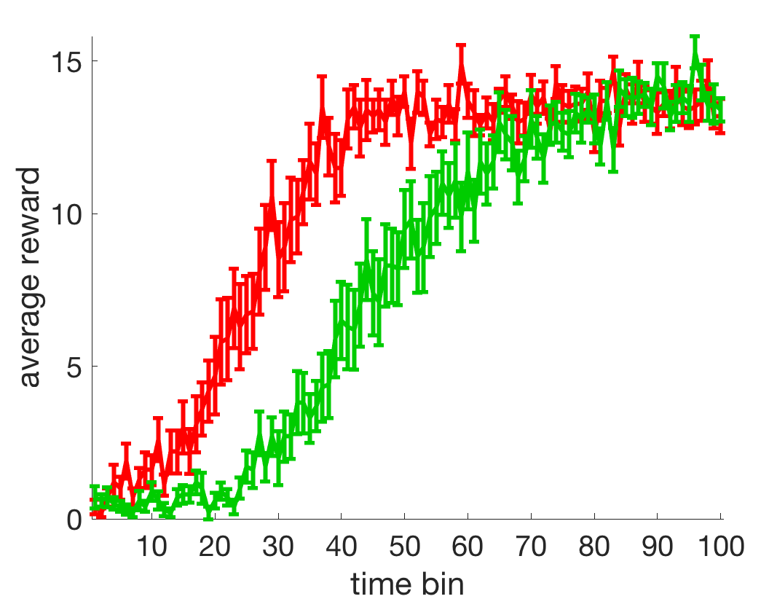
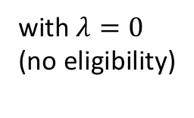

Eligibility trace
The agent learns faster with an eligibility trace, because rewards are backed up more rapidly
with $λ=0.2$
with $λ=0$
(no eligibility)
Neurally, eligibility traces may be mediated by slow timescales of learning or synaptic “tagging” at the synapse
See Gerstner (2018)

Slide 27






Multiple controllers for behaviour
Model based,
learning (and deciding) from mental simulation
flexible, costly
$$x$$
Model free,
learning from
experience
$$y=f(x,θ)$$
$$θ updated$$
inflexible, efficient
Daw & Dayan 2005; Dolan & Dayan 2013
Notes:
Note that it’s not that the network lacks the capacity to learn both tasks.
It’s easy to find a network paramaterisation that meets the objectives of both tasks A and B.
It can be found by training the network on an interleaved fashion, in which tasks A and B are mixed together.
However, life isn’t like that for humans. We usually perform tasks in an autocorrelated fashion. For example, I might play the violin in the morning and the piano in the afternoon, but rarely switch rapidly between them during a concert.

Slide 28


The options framework (HRL)
dACC lesions provoke failures of sustained action selection in a reversal learning task, i.e. in ability to stick to a fixed policy
ACC lesion
Neural evidence supports a role for the dACC in HRL
See Holroyd & Yeung 2012
Kennerley et al 2006

Slide 29

The options framework (HRL)
dACC neurons signal proximity to a reward during extended behaviours (black line)
This suggests that dACC neurons signal proximity to the termination of a sequence of actions
Shidara & Richmond 2002

Slide 30
Model-based tree search
kitchen
left
right
reward
backed up
fridge
oven
top
bottom
Tree search allows the most valuable path to be identified directly
apple
(reward)
empty
(no reward)
Notes:
Traditional systems in AI, on which Deep Blue is based, engaged in mean-end reasoning via a search process. For example, although there are a large possible number of board states, for each state, there are only a relatively limited number of legal moves. So it was possible to look ahead through a tree of possible future states, and pick the best one.
So this sounds great! Problem Solved.

Slide 31




Model-based tree search
…. and so on …
This is the class of method used by Deep Blue and many other AI systems for two-person games of perfect information
checkmate!!
Notes:
Traditional systems in AI, on which Deep Blue is based, engaged in mean-end reasoning via a search process. For example, although there are a large possible number of board states, for each state, there are only a relatively limited number of legal moves. So it was possible to look ahead through a tree of possible future states, and pick the best one.
So this sounds great! Problem Solved.

Slide 32


The two-step task
Task involves making two decision steps to obtain reward, with probabilistic transitions
Shows that humans use a mixture of model-based and model-free policies during a two-step bandit task
Notes:
Traditional systems in AI, on which Deep Blue is based, engaged in mean-end reasoning via a search process. For example, although there are a large possible number of board states, for each state, there are only a relatively limited number of legal moves. So it was possible to look ahead through a tree of possible future states, and pick the best one.
So this sounds great! Problem Solved.

Slide 33

Neocortex and subcortex
The basal ganglia are densely and reciprocally connected with the neocortex
Doya, 2007

Slide 34
Limitations of tabular RL
1. What is a “state”? The world is noisy and high-dimensional. How does RL work for complex problems?
2. RL performs poorly where rewards are sparse. To remedy this, we can use temporal abstraction (coming later)
3. Some functions just clearly require model-based methods. We can simulate counterfactuals, plan towards imagined goals, and reason using inductive logic. RL can’t explain this!
To explain these phenomena, we need model-based approaches. But in the next lecture, we will first consider a more fundamental question…how do we learn about “states” in the first place?
Notes:
Let’s begin with a question. What is really special about human intelligence? What makes us distinctive from that of other highly intelligent species, such as monkeys and birds?
Well, there are lots of anwers to this question, but in this talk I’d like to focus on one of them.

